Slide 1



Data Analysis
Notes:
Hello, I hope you are doing well! My name is Shaikh Minhaj, and today, I am excited to present the tasks I have completed during my internship.

Slide 2


Today's agenda
Project recap
Problem
The Analytics team
Process
Insights
Summary
Notes:
Today's agenda will be as follows:
We will recap the overall project to provide a high-level understanding of the business problem we are addressing and the specific requirements.
We will delve into the specific problem that the Data Analytics team has been focusing on and provide background on why it is significant.
After introducing the problem, I will introduce the team responsible for tackling this task from our side.
I will then outline the high-level process that we followed to complete this task, providing clarity on our approach.
Finally, I will present the all-important results as a series of insights and visualizations from our analysis.
To conclude, I will summarize and open the floor for any questions

Slide 3

S
Social Buzz is a fast growing technology unicorn that need to adapt quickly to it’s globle scale.
Accenture has begun a 3 month POC focusing on these tasks:
An audit of Social Buzz’s big data practice
Recommendations for a successful IPO
Analysis to find Social Buzz’s top 5 most popular categories of content
Project Recap
Notes:
To kick things off, let me recap this engagement.
Accenture has embarked on a 3-month pilot with Social Buzz, focusing on three main tasks aligned with some of the biggest challenges you're currently facing.
Social Buzz has achieved tremendous scale in recent years, establishing itself as a global unicorn company. We are here to assist you in managing this scale and guiding you in the right direction.
Firstly, we will conduct an audit of your big data practices and share best practices and industry expertise. Secondly, we will guide you through a successful IPO, drawing upon our team's deep expertise and knowledge. And finally, we have conducted an analysis of your data to uncover insights regarding your top 5 most popular content categories.

Slide 4

Problem
Over 100000 posts per day
36,500,000 pieces of content per year!
But how to Capitalize on it when there is so much?
Analysis to find Social Buzz’s top 5 most popular categories of content
Notes:
Focusing on the last point mentioned, this is what the Data Analytics team has been specifically focused on.
With such a grand scale, there comes a lot of data, and with vast amounts of data come challenges.
To provide background on the magnitude of data creation:
You informed us that your platform receives over 100,000 posts per day, totaling 36,500,000 posts every year. All of this data is unstructured, making it challenging to make sense of.
In this digital era, content reigns supreme. Just observe some of the largest platforms globally, such as YouTube, Facebook, and Netflix — they are all content-driven businesses.
However, how can one capitalize on such abundance?
It's not merely about accumulating as much content as possible. The true value lies in comprehending and analyzing this content to gain deeper insights into your audience and, consequently, providing a more personalized and enjoyable experience.
This is where our data analytics expertise comes into play. With the insights we've uncovered from this task, we can demonstrate precisely how to implement analytics at scale.

Slide 5


ANDREW FLEMING
Chief Technology Architect
The Analytics team
MARCUS ROMPTON
Senior Principal
TUSHAR KUMAR
Data Analyst
Notes:
Talking about experience, we have a large data analytics practice at Accenture but we had a team of 3 people primarily focusing on this task. Andrew Fleming is our Chief Technical Architect and his expertise really helped to guide the team to produce high quality analysis.
Marcus Rompton, a senior data expert has worked with the worlds biggest clients on solving their data problems and was heavily involved in the data engineering side of this project.
And finally myself, Shaikh Minhaj, who was solely responsible for taking leadership guidance and delivering high quality insights from the raw datasets and turning these into business decisions.

Slide 6
Process
1
Data Understanding
2
Data Cleaning
3
Data Modelling
4
Data Analysis
5
Uncover Insights
Notes:
Here's a refined version:
"So, how did we tackle this problem?
Well, we approached it in 5 steps:
1. Data understanding - Understanding the data thoroughly is crucial for success in any data project. Thus, we dedicated time to comprehend the data model and the domain of your business.
2. Data extraction - Following our understanding of your business, we designed an ideal dataset architecture for this problem and extracted relevant data from the appropriate sources.
3. Data processing and modeling - After extracting the raw data, our next step was to process and model it into a dataset that could precisely address the business questions and generate analytics.
4. Insight generation - Leveraging our analytical expertise, we delved into the new dataset to uncover insights and created visualizations to illustrate these findings.
5. Actionable recommendations - Finally, we utilized these insights to inform business decisions and provided recommendations for the next steps."

Slide 7

Insights
16
Unique Categories
Animal
Most Favorite Category
May
Month with
Most Number of posts
Notes:
From your data we found that you had a total of 16 unique categories of posts across your sample dataset. This includes things such as Food, Culture and Sport.
As well as this, there was 1091 posts from just the Food category alone! People obviously really like food!
And also the most common month for users to post within was December, since this is such a seasonal month with so many holidays and events, this is interesting to know that people are most active during this month!
But now, onto the main question... which is... what were the top 5 most popular categories of posts?

Slide 8
Notes:
From our analysis you can see that the top 5 most popular categories of posts were food, culture, soccer, cooking and animals in descending order.
Food had an aggregate popularity score of almost 1100. It is very interesting to see both food and cooking within the top 5, it really shows what people enjoy consuming as content. But also interesting to see culture too. Clearly users favor "real-life" content on this platform.
Furthermore soccer is an interesting category because there is the European championships being played very soon. This presents a huge opportunity for you to differentiate your platform and to run specific content or events linked to this global spectacle.

Slide 9
Notes:
Additionally, you can see from this chart the % split of popularity between the top 5 categories. There is not much difference between each of them, food only outperforms culture by 0.4% within the top 5.
However the difference between the 4th most popular, cooking, and the 5th most popular, animals, is much larger at 1.3%
This tells me that the categories sorted by popularity is weighted towards categories at the top. This means that it exhibits a "greedy" effect, the most popular categories get more popular whilst as you drop down the popularity rankings, you may see that they fall away drastically.

Slide 10

ANALYSIS
Science and Technology are the most popular categories of content showing that people enjoy “real-life” and “factual” content the most.
INSIGHT
Food is a common theme with the top 5 Categories with “Science” ranking the highest. This may give an indication to the audience within your user base. You could use the insight to create a campaign and work with healthy eating brands to boots user engagement.
Summary
NEXT STEPS
This ad-hoc analysis is insightful, but it’s time to take this analysis into large scale production for real-time understanding of your business. We can show you how to do this.
Notes:
So to summarize:
We tackled this task and found the top 5 most popular categories as asked, but we also went one step further.
- We found that food and culture are the two most popular categories, suggesting that users like "real-life" content
- We also found that soccer was the third most popular, perhaps due to the tournament coming up. This presents a massive opportunity for Social Buzz to ride on this global event, as all eyes will be on it as well as the players.
- As much as this analysis was insightful, we are ready to take it to the next stage and we have the expertise within Accenture to help you realize these kinds of insights in production across your organization and in real time. We would love to help you with this.

Slide 11
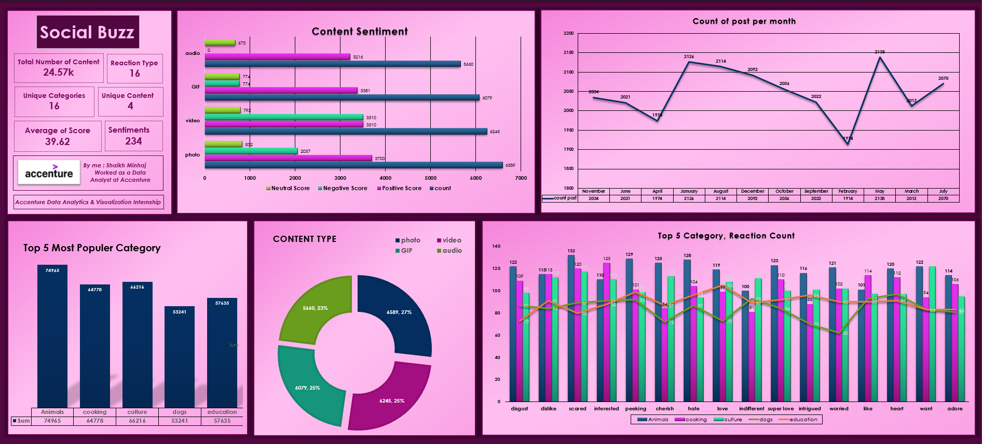
Notes:
Dashboard in Excel – Social Buzz Insights

Slide 12
Thank you!
ANY QUESTIONS?
Notes:
Thank you very much for listening, please feel free to ask any questions that you may have!

